Slide 1
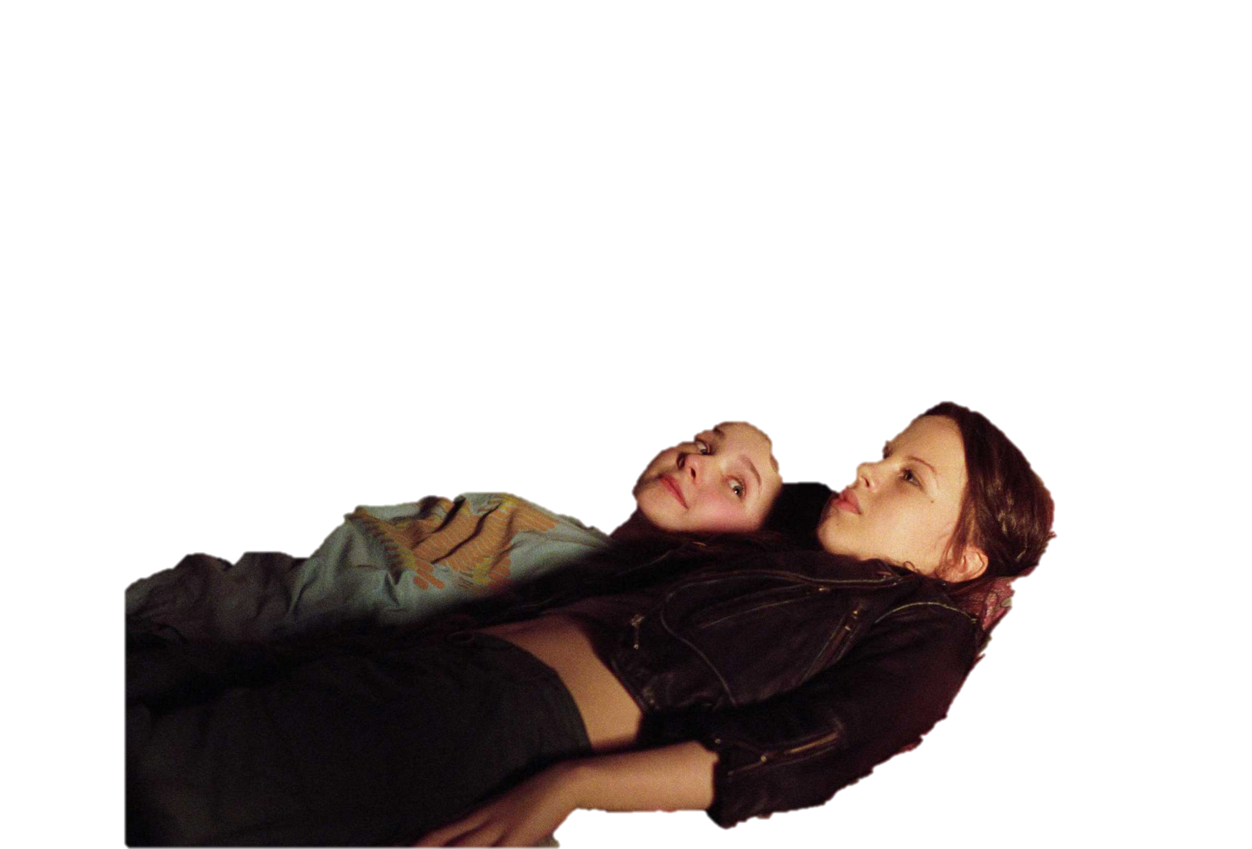


My Sisters Keeper
From the director of ‘The Notebook’

Slide 2

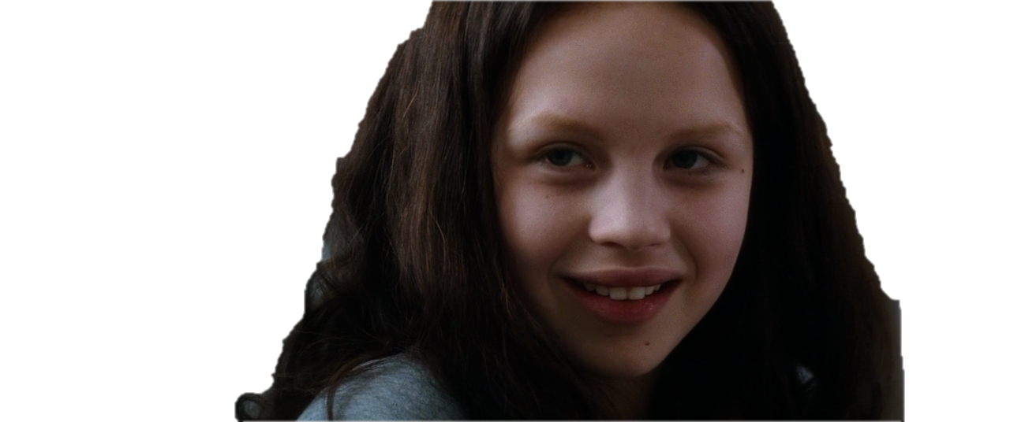
Kate has cancer and Anne is the only one with the same blood type and the only one that can donate things to her.
Ever since Anne was an infant she has been the one responsible for keeping her older sister, Kate, alive.
Anne
Kate

Slide 3
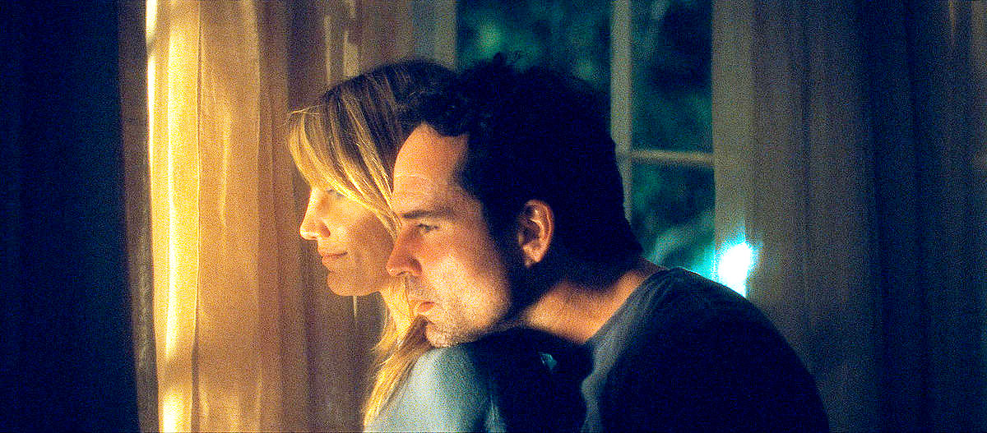
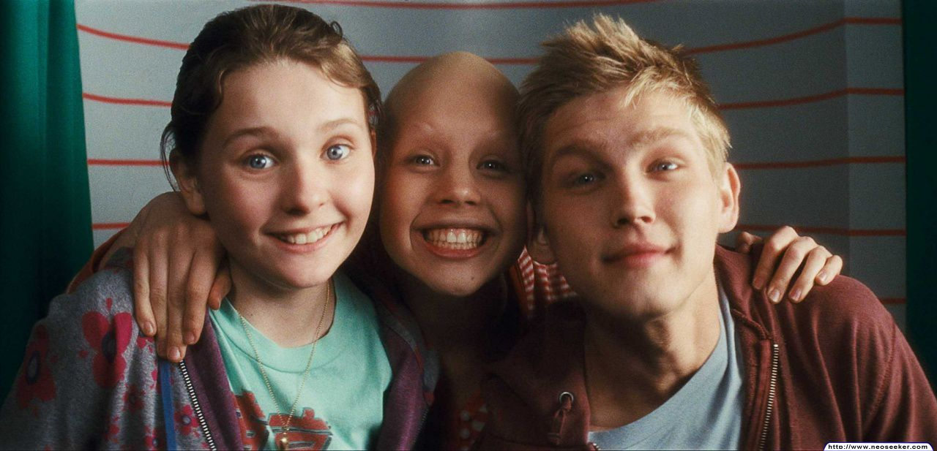
The only reason Sara and Brain decided to have another child was to save Kate, because the doctor said that was the only way.
They had a son already, but he was no match for her. So they had Anne.

Slide 4
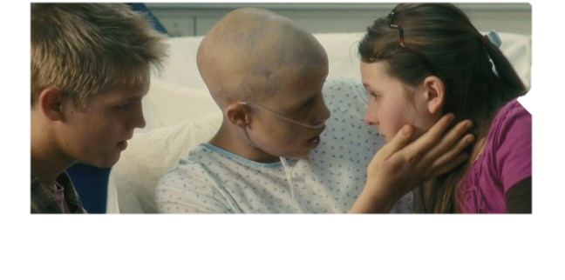
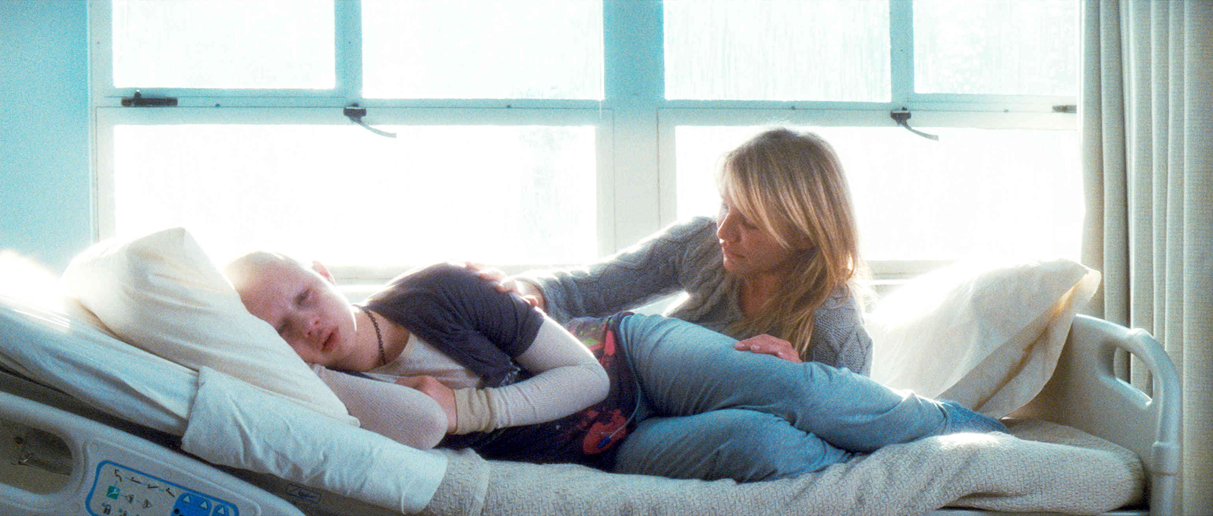

Kate feels like she’s ruining the family’s lives.
And Anne has spent just as much time in the hospital as she has. Kate feels like she has stolen her little sisters life.
When her brother was eight he was dyslexic but their parents didn’t even notice because they were so focused on Kate getting better.
She feels like she has taken away all the love and attention that they deserve.

Slide 5

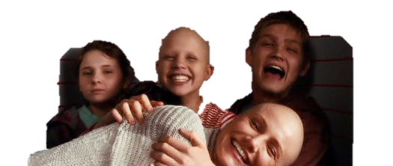
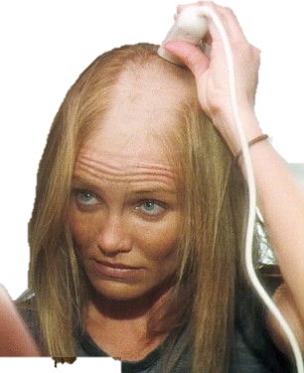
Kate also feels like she stole her mothers life. Her life revolves around caring for Kate.
She even shaved her head when Kate lost all her hair.

Slide 6
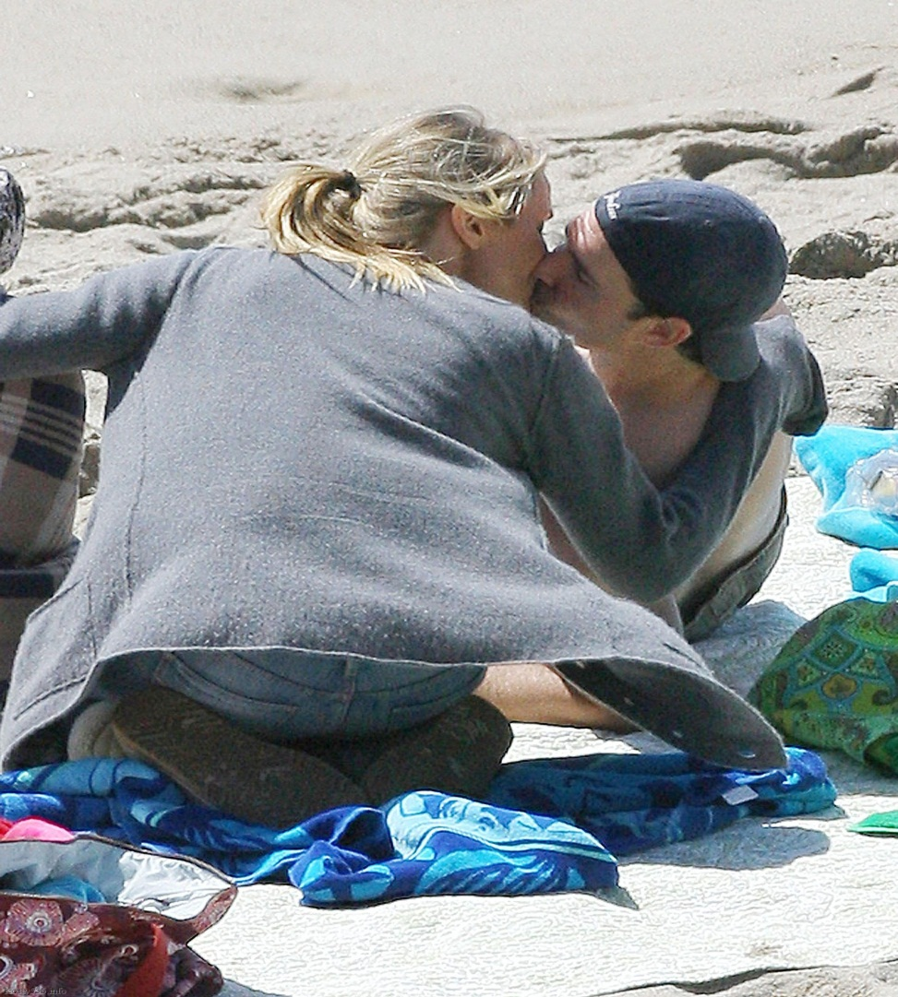
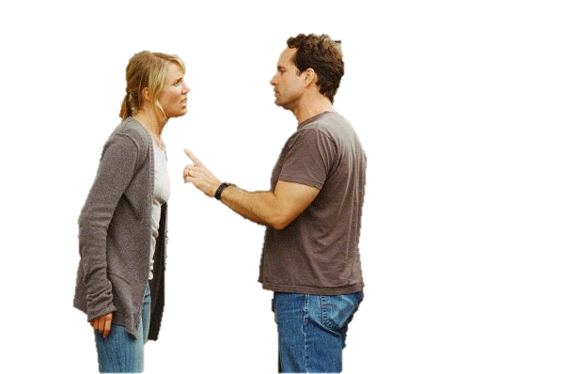
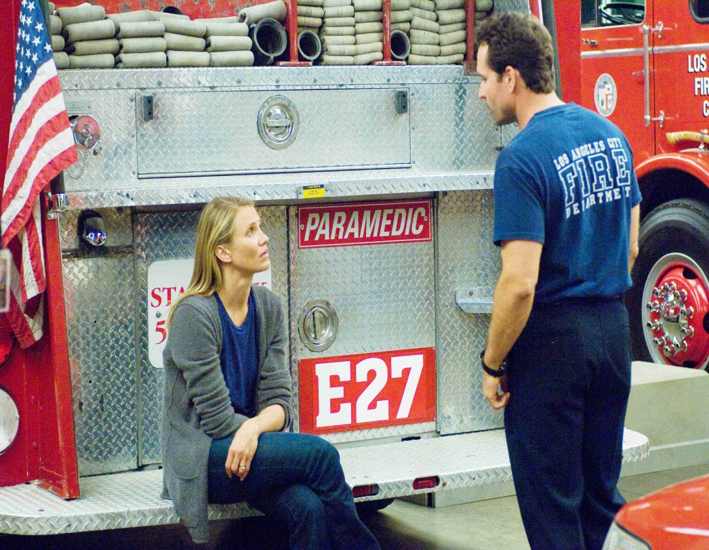

Kate thinks she stole the love of her fathers life too. They never have time to themselves. She can tell he misses her.
Now they argue often, rather than getting along like before.
“It’s like you’re a stranger now..”

Slide 7
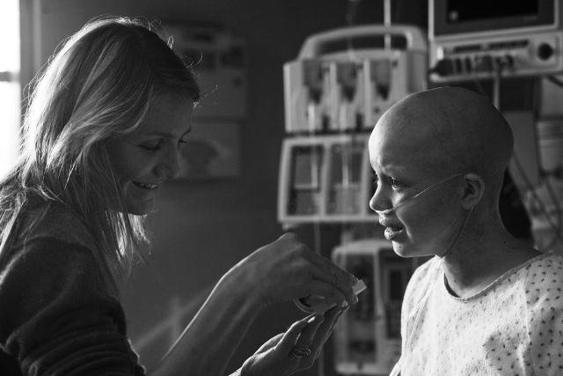
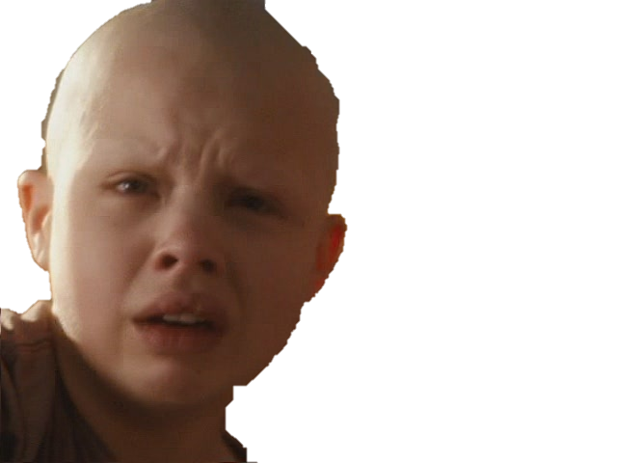
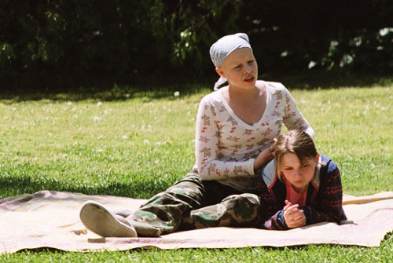
It’s really hurting Kate to watch her family suffer. Especially because she feels that it’s all her fault for all their problems.
“I’m so sorry.”
So Kate tells Anne, to take control of her body and tell her parents that she will not do the kidney transplant for Kate.
Kate is also getting tired.

Slide 8
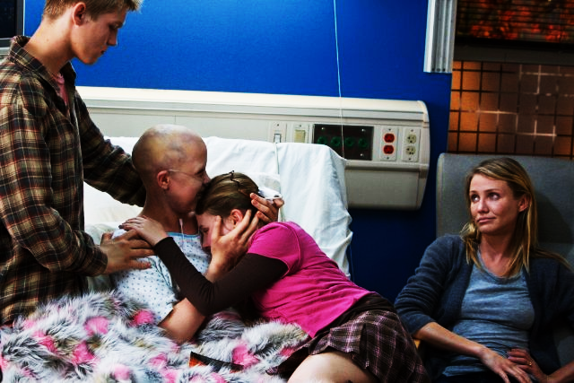
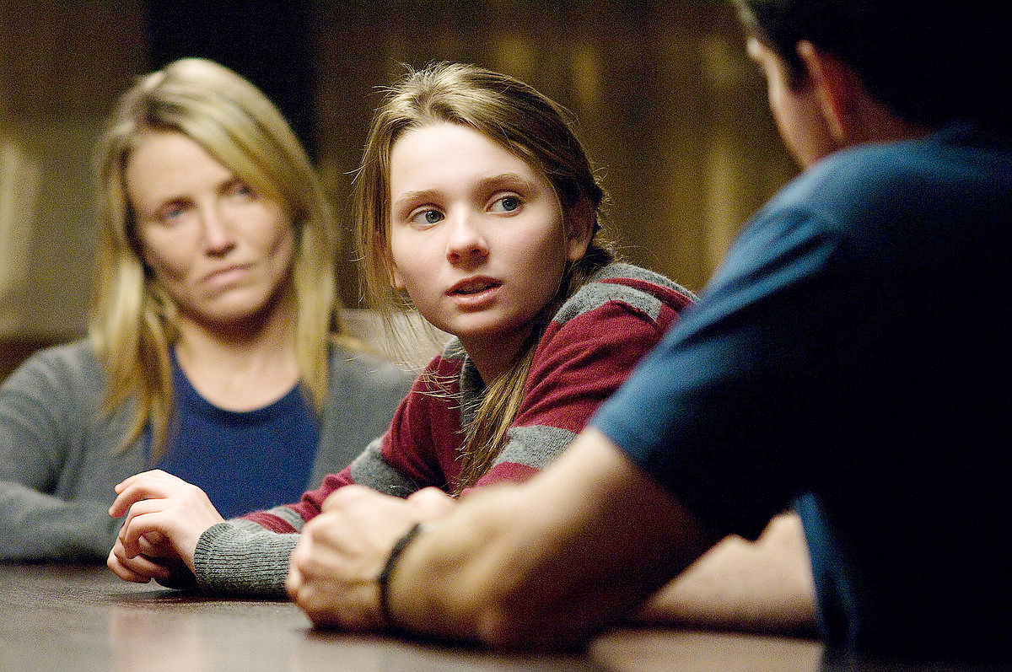
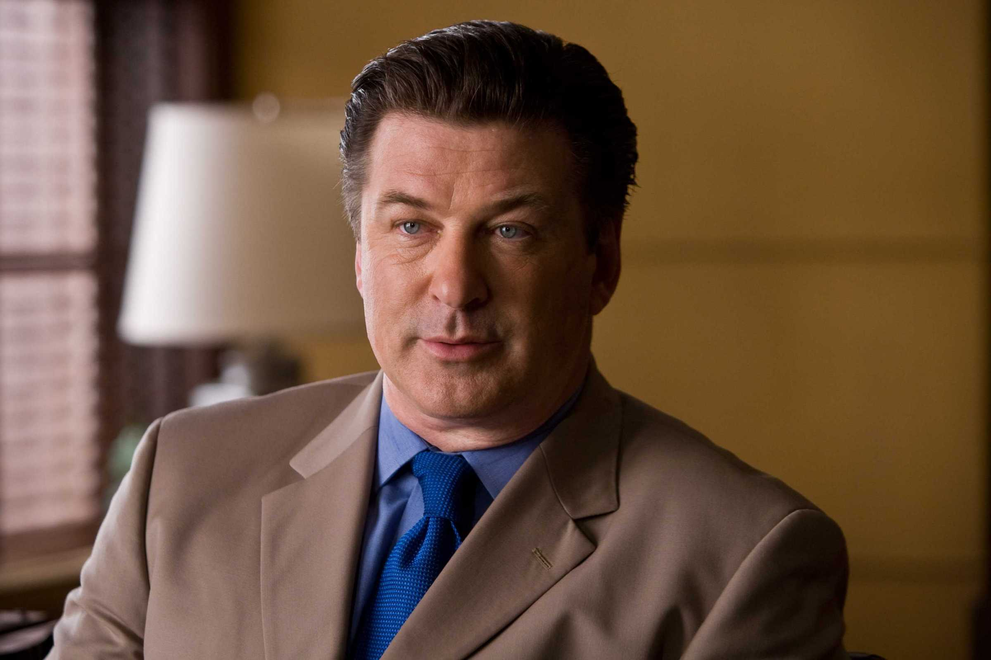
Anne knows what will happen if she doesn’t do the kidney transplant. Kate will die.
Their mother is outraged when Anne tells her she refuses to do the kidney transplant.
Their mother tries to force Anne to do the kidney transplant, so Anne and her brother hire a lawyer.
But that’s what Kate wants, so Anne agrees to Kate’s request and her brother agrees to support Anne.
Their father is a little more understanding

Slide 9
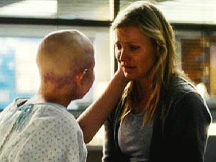
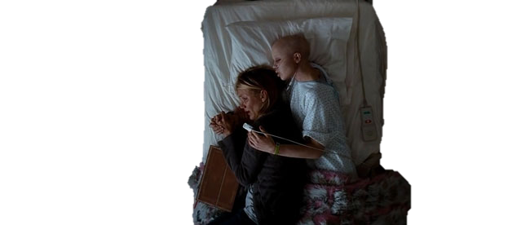
Kate realizes thats causing more problems. So she just admits to her mother that she convinced Anne to refuse the kidney transplant.
Her mother has a hard time accepting this. She doesn’t want to let her daughter go.

Slide 10
Kate makes one final request.

Slide 11

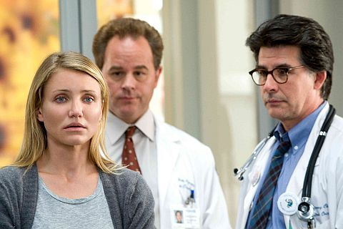
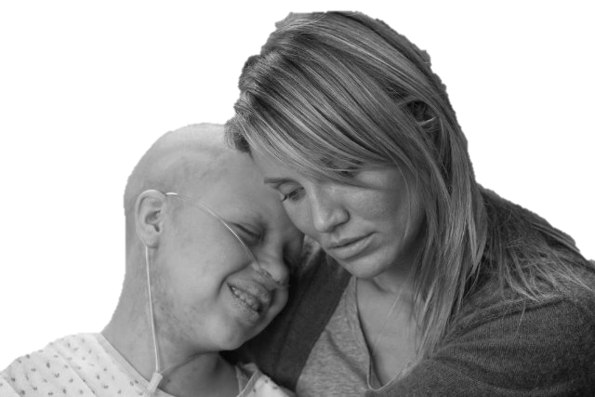
She wants to go to the beach one last time.
This terrifies her mother. She’s scared to take her out of the hospital. She wants to hold on as long as she can.
But the doctor gives the okay and they go.

